Slide 1


Don’t forget to get your…
Available in the Lobby!!!

Slide 2

PRETTY GOOD for 13 Minutes
devs
PowerShell
Bryan Cafferky
BPC Global Solutions LLC

Slide 3

PRETTY GOOD for 13 Minutes
devs
PowerShell

Slide 4
PRETTY GOOD for 13 Minutes
devs
PowerShell

Slide 5

PowerShell
Mission
Possible!

Slide 6


Slide 7
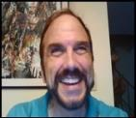


About Bryan Cafferky…
Microsoft Technical Solutions Enabler (TSP)
Microsoft 2016 Cloud and Data Center Platform MVP, 2017 Data Platform MVP
Decades of IT Experience
Author of Pro PowerShell for Database Developers
Experienced in health care, insurance, banking, and ecommerce
Founded and lead PASS Chapter The RI Microsoft BI User Group and The SNE UseR Group
Frequent presenter at technical conferences and user groups
Proud to be a Nerd.
bryan256@msn.com
www.sql-fy.com
https://www.linkedin.com/in/bryancafferky
@BryanCafferky – follow me!

Slide 8
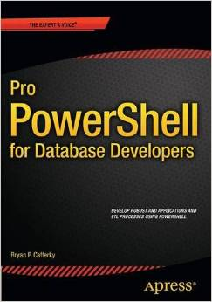
Author of…
Available on Amazon

Slide 9
Goals of this Presentation
Why You Need PowerShell
Provide an Overview of PowerShell’s architecture and Features
Provide a Basic Understanding of PowerShell Programming
Point You to Where You Can Get Support

Slide 10
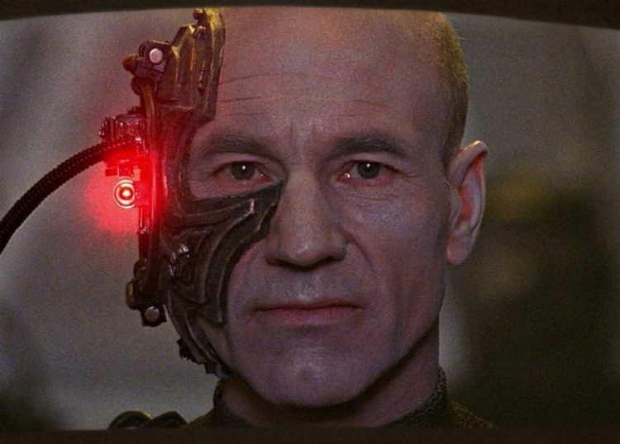
Manual Processes Don’t Scale
Resistance is Futile

Slide 11
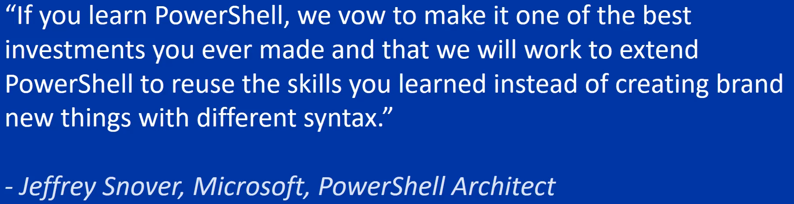

The Sacred Vow

Slide 12


Why PowerShell?
Without PowerShell
With PowerShell

Slide 13




Your Commitment
Be an Explorer
Be Patient
Remember: Everyone is in a different place.
Have Fun!
Imagine

Slide 14
Challenges
Doing what we know
Deadlines
Takes time to become competent
PowerShell is not always intuitive
The easy way is not always obvious at first

Slide 15
PowerShell Ecosystem
Ease of Use
Administration
Programming
Extensions
Configuration/
Profiles
Remoting
Advanced Functions
Cloud Automation
Explorability
Job System
Object Orientation
Work Flow
Reusability
Providers
Object Based Piping
Desired State Configuration
(DSC)

Slide 16
Connecting it All
SQL Server
Windows Server
File System
PowerShell
SharePoint
Exchange Server
Active Directory
IIS
Azure

Slide 17
Remote Execution
Enable-PSRemoting -Force
Dev Server 1
Mary Smith’s Computer
DNS Server
Invoke-Command
Get-EventLog
Restart-Computer
PowerShell
Dev Server 2
Prod Server 1
Set-Service
Restart-Service
Show-EventLog
Test-Connection
Enable-PSRemoting -Force
Dev Server 3
John Doe’s Computer
Prod Server 2

Slide 18
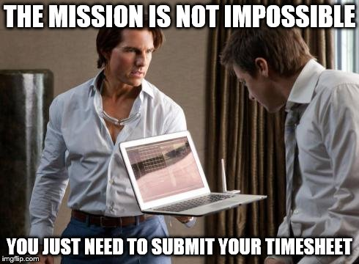

Slide 19
What is PowerShell?

Slide 20
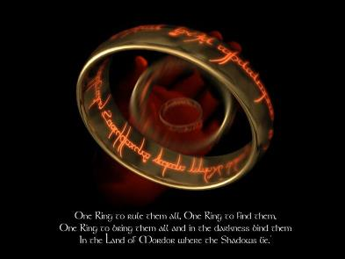
One Shell to Rule Them All
Notes:
This template can be used as a starter file for presenting training materials in a group setting.
Sections
Right-click on a slide to add sections. Sections can help to organize your slides or facilitate collaboration between multiple authors.
Notes
Use the Notes section for delivery notes or to provide additional details for the audience. View these notes in Presentation View during your presentation.
Keep in mind the font size (important for accessibility, visibility, videotaping, and online production)
Coordinated colors
Pay particular attention to the graphs, charts, and text boxes.
Consider that attendees will print in black and white or grayscale. Run a test print to make sure your colors work when printed in pure black and white and grayscale.
Graphics, tables, and graphs
Keep it simple: If possible, use consistent, non-distracting styles and colors.
Label all graphs and tables.

Slide 21
What is PowerShell?

Slide 22
PowerShell = Windows Shell
The legacy Windows Shell is the Command Prompt, a carry over from DOS. It is not designed to work with Windows.
The completely new and re-architected Windows Shell is PowerShell.
PowerShell was designed from the ground up to integrate with .Net and anything in the Windows environment.

Slide 23
Features of PowerShell
Extensible via Modules which can be created in PowerShell.
Supports object orientation features like defining classes and inheritance.
Supports parallel remote execution of PowerShell scripts or commands.
Can inline compile and run C# code.
Custom code can inherit PowerShell common functionality known as common parameters.
Seamlessly integrated with .Net.

Slide 24


Slide 25
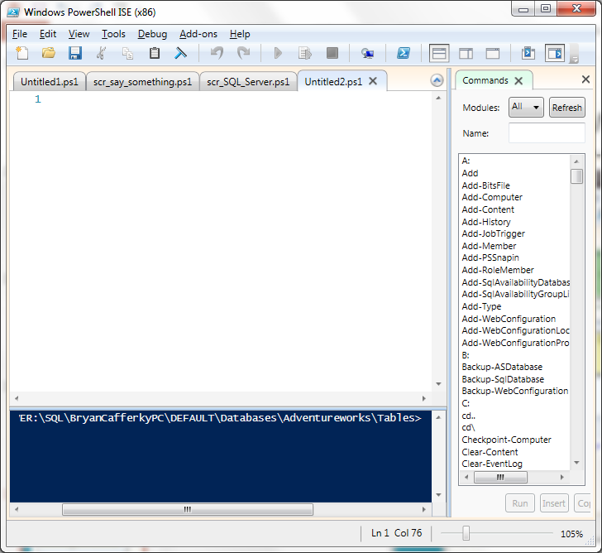
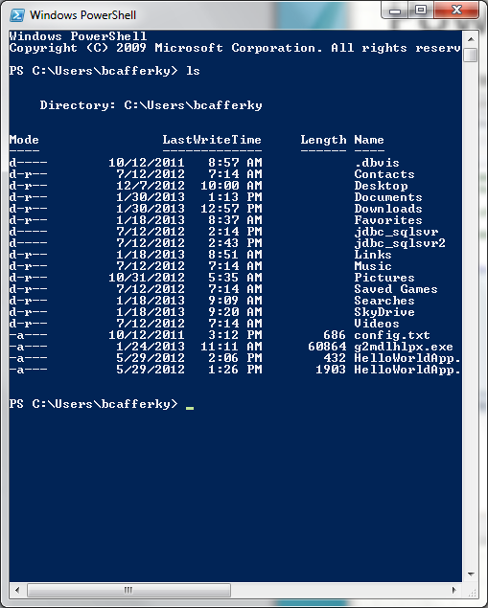
PowerShell Environments
The PowerShell ISE
… or …
The PowerShell CLI
Notes:
If there is relevant video content, such as a case study video, demo of a product, or other training materials, include it in the presentation as well.

Slide 26
PowerShell Environments
A Brief Tour…
Notes:
If there is relevant video content, such as a case study video, demo of a product, or other training materials, include it in the presentation as well.

Slide 27
PowerShell CMDLET - Pronounced "command-let“
A Command
Verb and Noun separated by a dash (-) such as Get-Process
The verb gives you an idea of what the cmdlet does
"get" cmdlets only retrieve data,
"set" cmdlets only establish or change data,
"format" cmdlets only format data,
"out" cmdlets only direct the output to a specified destination..
Each cmdlet has a help file that you can access by typing:
get-help <cmdlet-name> -detailed
Example: get-help write-host
Notes:
Discuss outcomes of the case study or class simulation.
Cover best practices.

Slide 28
CMDLET Examples
Get-Help *
Get-Process
Get-Location
Set-Location C:\
Write-Host “Hello”
Get-WMIObject Win32_BIOS
Set-ExecutionPolicy RemoteSigned
Notes:
Summarize presentation content by restating the important points from the lessons.
What do you want the audience to remember when they leave your presentation?
Save your presentation to a video for easy distribution (To create a video, click the File tab, and then click Share. Under File Types, click Create a Video.)

Slide 29
CMDLET Naming
Microsoft has strict naming standards.
Verbs must be selected from the Microsoft Approved list.
The noun has more flexibility but should be the object of the verb.
Example: Get-udfUserName
Approved Verbs can be found at:
https://technet.microsoft.com/en-us/library/ms714428%28v=vs.85%29.aspx
Notes:
Summarize presentation content by restating the important points from the lessons.
What do you want the audience to remember when they leave your presentation?
Save your presentation to a video for easy distribution (To create a video, click the File tab, and then click Share. Under File Types, click Create a Video.)

Slide 30
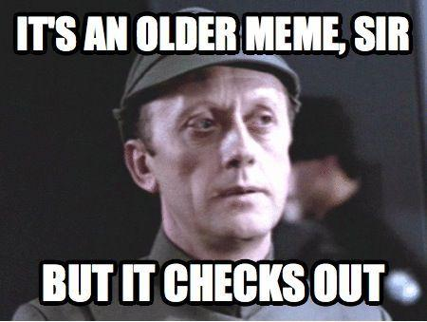

Slide 31
PowerShell – Common Uses
Azure environment creation and maintenance.
Do pre and post job processing.
Database Support (SQL Server Integration)
Class reflection to query class methods and properties
Security Administration (Active Directory)
Working with MS Products; SharePoint, Office, etc.
Working with XML and JSON
Notes:
Give a brief overview of the presentation. Describe the major focus of the presentation and why it is important.
Introduce each of the major topics.
To provide a road map for the audience, you can repeat this Overview slide throughout the presentation, highlighting the particular topic you will discuss next.

Slide 32
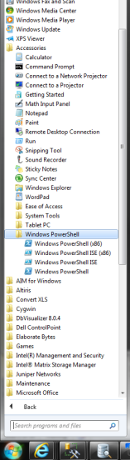
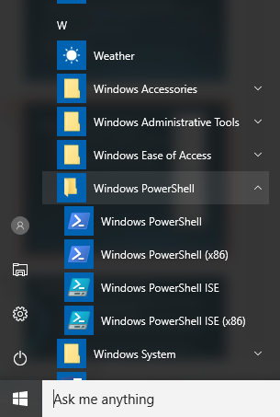
Starting PowerShell
Pre Windows 10
Windows 10
CLI
ISE
(x86) = 32 bit versions
Notes:
Give a brief overview of the presentation. Describe the major focus of the presentation and why it is important.
Introduce each of the major topics.
To provide a road map for the audience, you can repeat this Overview slide throughout the presentation, highlighting the particular topic you will discuss next.

Slide 33
PowerShell: Before You Can Run a Script…
Code Signing and Certificates
You need to set the security policy for PowerShell using the Set-ExecutionPolicy cmdlet
Set-ExecutionPolicy RemoteSigned
Restricts scripts to run from local machine only.

Slide 34
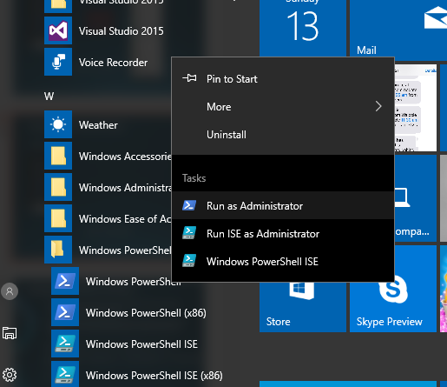
Starting PowerShell
Run as Administrator
(x86) = 32 bit versions
Notes:
Give a brief overview of the presentation. Describe the major focus of the presentation and why it is important.
Introduce each of the major topics.
To provide a road map for the audience, you can repeat this Overview slide throughout the presentation, highlighting the particular topic you will discuss next.

Slide 35
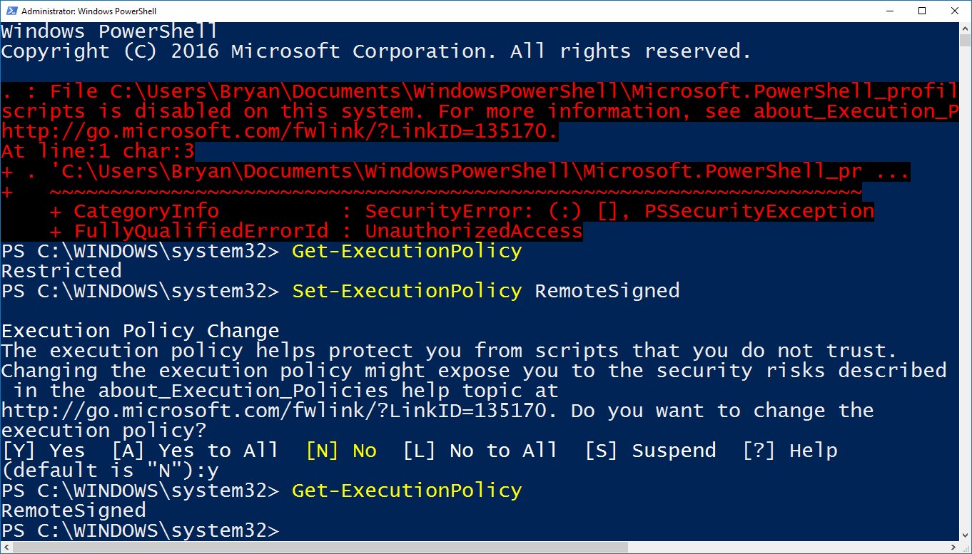
Enabling Scripts
Profile Script Fails Because Scripting is not enabled,.
Check Execution Policy.
Allow Scripts.
Confirm Change.
Notes:
Give a brief overview of the presentation. Describe the major focus of the presentation and why it is important.
Introduce each of the major topics.
To provide a road map for the audience, you can repeat this Overview slide throughout the presentation, highlighting the particular topic you will discuss next.

Slide 36
PowerShell: Set-ExecutionPolicy options
Set-Executionpolicy unrestricted
Set-ExecutionPolicy Restricted
Restricted - No scripts can be run. Windows PowerShell can be used only in interactive mode.
AllSigned - Only scripts signed by a trusted publisher can be run.
RemoteSigned - Downloaded scripts must be signed by a trusted publisher before they can be run.
Unrestricted - No restrictions; all Windows PowerShell scripts can be run.

Slide 37

What do Star Trek and Mission Impossible have in common?

Slide 38
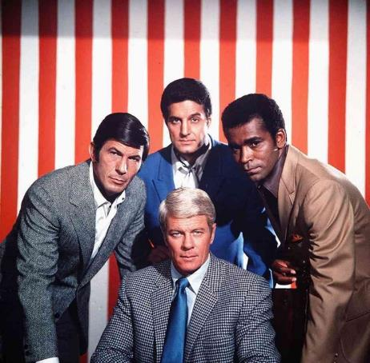
Leonard Nimoy

Slide 39
PowerShell Providers
A provider is a folder like interface to a resource such as Active Directory, the Registry, SQL Server, or variables.
They are implemented in many places.
Most useful for direct command line manipulation.

Slide 40
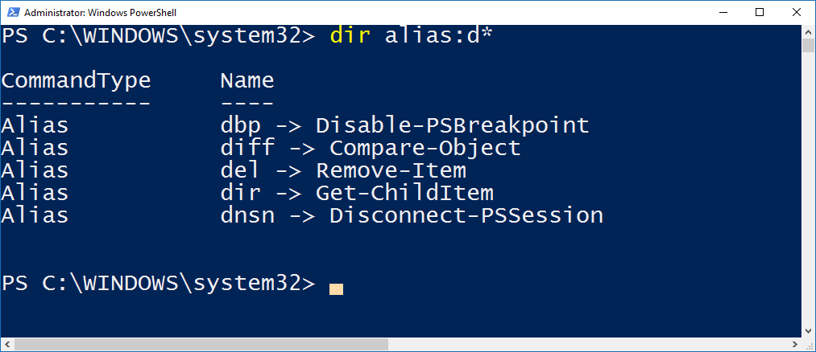
Providers: Alias
Alias collection is treated like a folder.
Can use wild cards.
Dir is just an alias for Get-ChildItem.
Notes:
Give a brief overview of the presentation. Describe the major focus of the presentation and why it is important.
Introduce each of the major topics.
To provide a road map for the audience, you can repeat this Overview slide throughout the presentation, highlighting the particular topic you will discuss next.

Slide 41
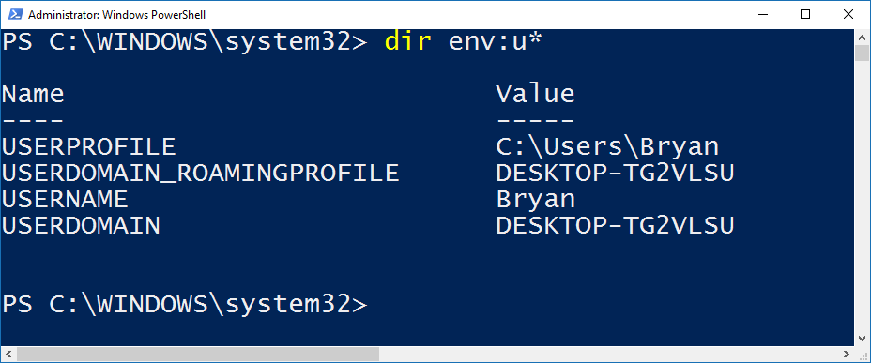
Providers: Environment Variables
Environment variables via Provider Interface.
Notes:
Give a brief overview of the presentation. Describe the major focus of the presentation and why it is important.
Introduce each of the major topics.
To provide a road map for the audience, you can repeat this Overview slide throughout the presentation, highlighting the particular topic you will discuss next.

Slide 42
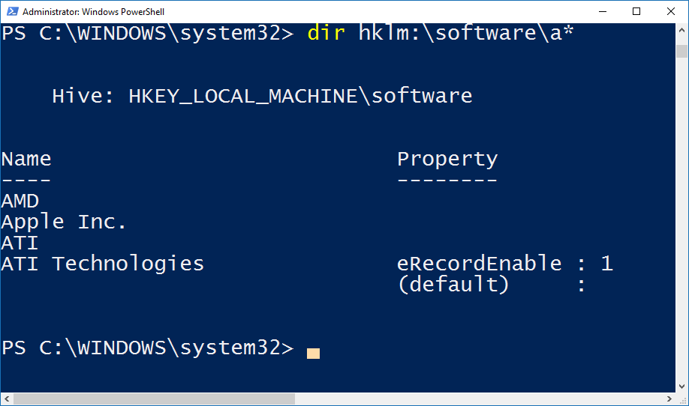
Providers: The Windows Registry
hklm points to the registry root.
Can edit, delete, and add keys through the registry provider.
Transaction checkpoint/restore via Start-Transaction, Undo-Transaction, and
Complete-Transaction. Undo-Transaction rolls back the changes.
Notes:
Give a brief overview of the presentation. Describe the major focus of the presentation and why it is important.
Introduce each of the major topics.
To provide a road map for the audience, you can repeat this Overview slide throughout the presentation, highlighting the particular topic you will discuss next.

Slide 43
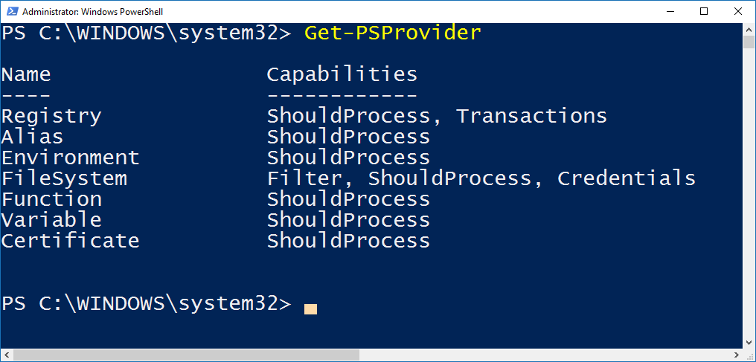
Providers Available
Notes:
Give a brief overview of the presentation. Describe the major focus of the presentation and why it is important.
Introduce each of the major topics.
To provide a road map for the audience, you can repeat this Overview slide throughout the presentation, highlighting the particular topic you will discuss next.

Slide 44
Starting the ISE
Pre Windows 10
Windows 10
Start the ISE
(x86) = 32 bit versions
Notes:
Give a brief overview of the presentation. Describe the major focus of the presentation and why it is important.
Introduce each of the major topics.
To provide a road map for the audience, you can repeat this Overview slide throughout the presentation, highlighting the particular topic you will discuss next.

Slide 45
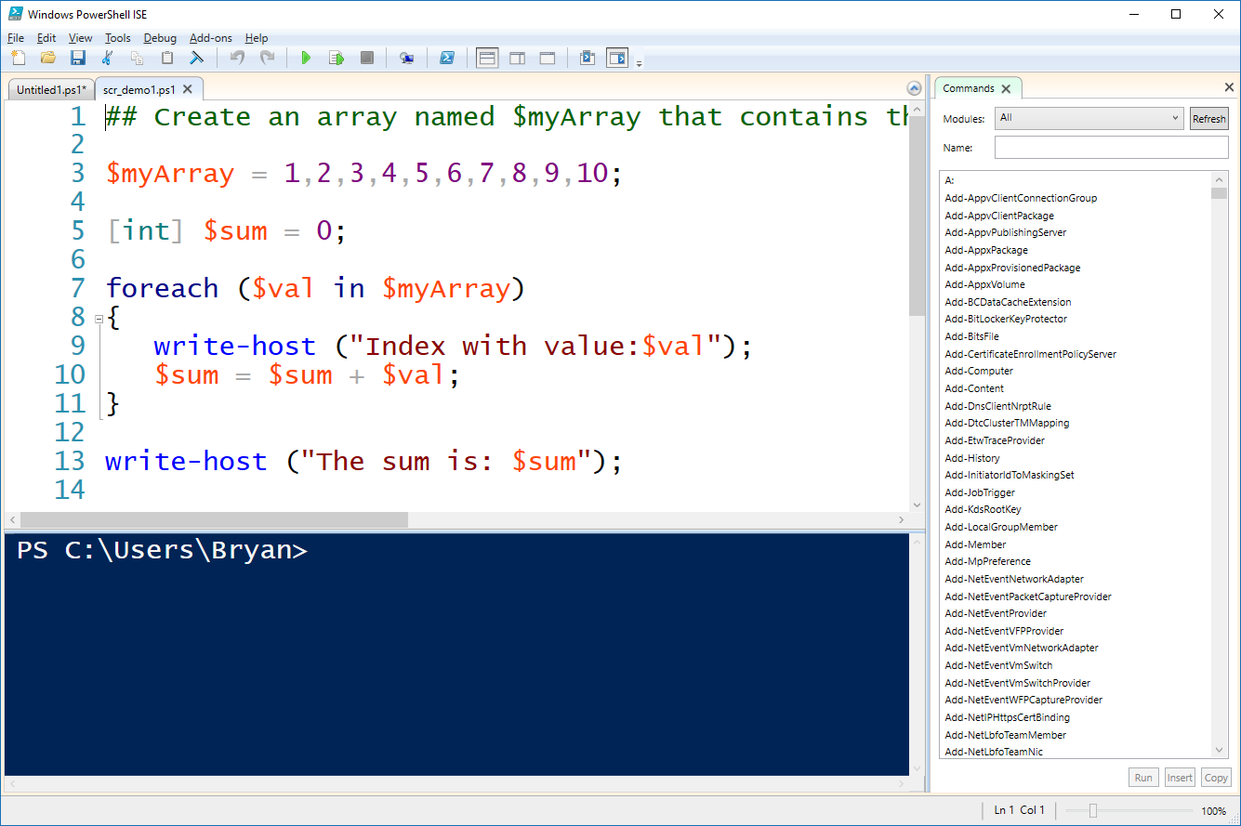
The PowerShell ISE
Script Editor
Console
Notes:
Give a brief overview of the presentation. Describe the major focus of the presentation and why it is important.
Introduce each of the major topics.
To provide a road map for the audience, you can repeat this Overview slide throughout the presentation, highlighting the particular topic you will discuss next.

Slide 46
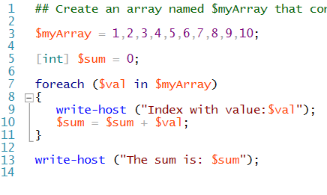
Syntax
# for inline comment and <# #> for comment block.
Variable names start with $.
Strong data typing.
Script_demo1.ps1
Braces mark code blocks.
Variables in strings expand by default when printed.

Slide 47
Variables Types
Name | Data Type
[datetime] | Date or time
[string] | String of characters
[char] | Single character
[double] | Double-precision floating number
[single] | Single-precision floating number
[int] | 32-bit integer
[wmi] | Windows Management Instrumentation (WMI) instance or collection
[adsi] | Active Directory Services object
[wmiclass] | WMI class
[Boolean] | True or False value

Slide 48
What do Space 1999 and Mission Impossible have in common?

Slide 49

Martin Landau
Notes:
Give a brief overview of the presentation. Describe the major focus of the presentation and why it is important.
Introduce each of the major topics.
To provide a road map for the audience, you can repeat this Overview slide throughout the presentation, highlighting the particular topic you will discuss next.

Slide 50
PowerShell – Critical Concepts
Basic (scr_basic, scr_main)
Function (Invoke-udfSpeech)
Piping (scr_pipeline_example, scr_pipeline_demo)
Advanced functions (CmdLetBinding) (scr_cmdletbinding)
Parameter validation. (Invoke-ufnFoo)
Modules (umd_module.psm1, scr_use_module)
Workflows (scr_workflow_sample1)
Object Orientation (scr_09_class_demo)
Notes:
Give a brief overview of the presentation. Describe the major focus of the presentation and why it is important.
Introduce each of the major topics.
To provide a road map for the audience, you can repeat this Overview slide throughout the presentation, highlighting the particular topic you will discuss next.

Slide 51
PowerShell – Recipes
HTML Output (ufn_out_html)
SQL Server. (scr_SQL_Server, scr_winform_sql)
Wait for file polling. (ufn_wait_for_file)
Maintaining Data. (scr_gridview_passthru, scr_maintain_data)
Import/Export Excel files. (scr_SQLServer_2_Excel)
Notes:
Give a brief overview of the presentation. Describe the major focus of the presentation and why it is important.
Introduce each of the major topics.
To provide a road map for the audience, you can repeat this Overview slide throughout the presentation, highlighting the particular topic you will discuss next.

Slide 52


Slide 53
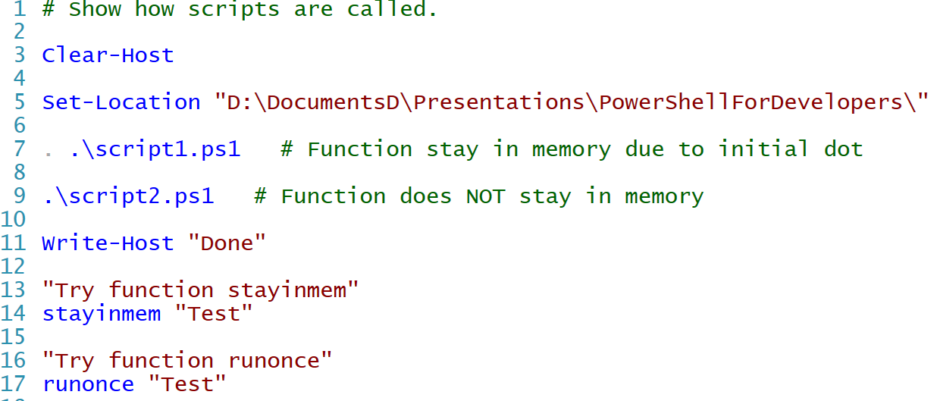
PowerShell: Calling other scripts
Retain functions in memory.
In current folder.
Main.ps1

Slide 54
PowerShell – Periods Matter
PowerShell will not default to the current folder.
.\my_function.ps1 # Refers to a script in the current folder.
C:\Scripts\Test.ps1 # Refers to a script not in the current folder.
Use Dot Sourcing to call the script and keep it in memory.
. c:\scripts\test.ps1 # Run the script and keep the functions and variables after it is done, i.e. available to the session.
. .\my_function.ps1 # Run script which is in the current folder and keep the functions and variables after it is done.
Space in the path?
& “C:\My Scripts\Test.ps1” # Run script with space in the path.
Notes:
Give a brief overview of the presentation. Describe the major focus of the presentation and why it is important.
Introduce each of the major topics.
To provide a road map for the audience, you can repeat this Overview slide throughout the presentation, highlighting the particular topic you will discuss next.

Slide 55
Variables Are Objects
A variable is an object with methods and properties.
You can set the scope of a variable such as
Set-Variable -scope Global -name SqlServerMaximumChildItems -Value
By default a variable is created to be in the current scope and any child scopes.
A variable can hold different types of data unless it was type casted on creation.
$myvar = “test”
$myvar = 1
[string] $myvar = “test”
$myvar = 3 # will produce an error

Slide 56
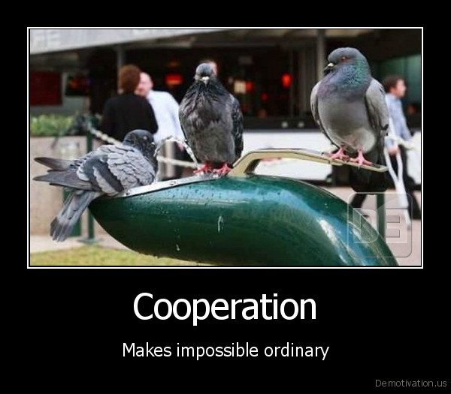

Slide 57
PowerShell – Very Well Supported
Resources:
The PowerShell Gallery – Tons of Free Reusable Modules
https://www.powershellgallery.com/
Downloads and Information
http://www.microsoft.com/windowsserver2003/technologies/management/
Training/Documentation
http://technet.microsoft.com/en-us/scriptcenter/powershell.aspx
Documentation
http://technet.microsoft.com/en-us/library/bb978526.aspx
Free Training
http://pragmaticworks.com/LearningCenter/FreeTrainingWebinars/FutureWebinars.aspx
Notes:
Add a case study or class simulation to encourage discussion and apply lessons.

Slide 58
Wrapping Up: Why PowerShell?
Full Support by Microsoft. A must for Azure!
A rich and full language!
Integrated into Windows and Windows Based Products.
Lot’s of Free Scripts Available.
Microsoft and Other Vendors Are Including Them More and More With Products.
Notes:
Is your presentation as crisp as possible? Consider moving extra content to the appendix.
Use appendix slides to store content that you might want to refer to during the Question slide or that may be useful for attendees to investigate deeper in the future.

Slide 59
Review
Why You Need PowerShell
Overview of PowerShell’s Architecture and Features
Basic Understanding of PowerShell Programming
Where You Can Get Support

Slide 60

Q & A
Notes:
Is your presentation as crisp as possible? Consider moving extra content to the appendix.
Use appendix slides to store content that you might want to refer to during the Question slide or that may be useful for attendees to investigate deeper in the future.

Slide 61
Q & A
Notes:
Is your presentation as crisp as possible? Consider moving extra content to the appendix.
Use appendix slides to store content that you might want to refer to during the Question slide or that may be useful for attendees to investigate deeper in the future.

Slide 62
Appendix
Notes:
Is your presentation as crisp as possible? Consider moving extra content to the appendix.
Use appendix slides to store content that you might want to refer to during the Question slide or that may be useful for attendees to investigate deeper in the future.

Slide 63
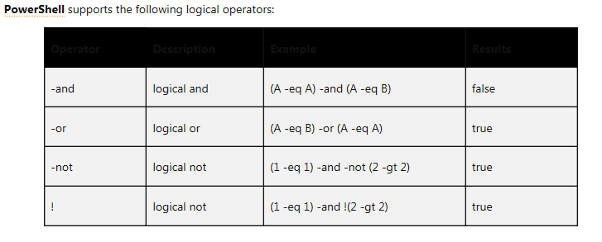
Logical Operators…

Slide 64
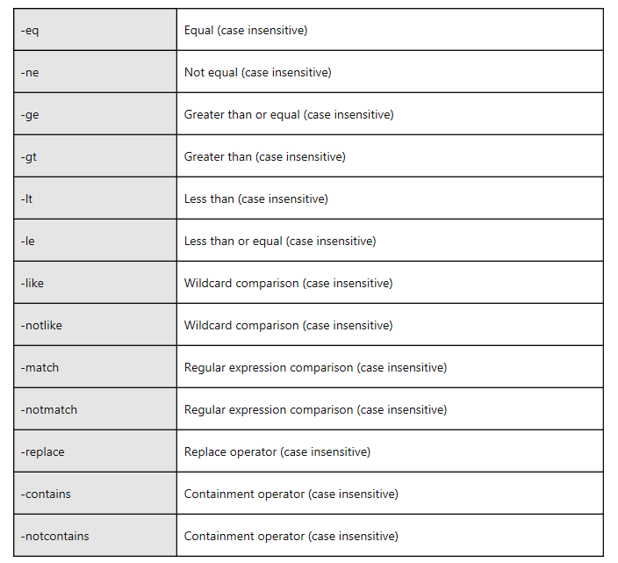
Comparison Operators…
Comparison Operators are NOT Case Sensitive By Default…

Slide 65
Variables Methods
(123).equals(456) will return false (123).CompareTo(150)will return -1 (123).ToString()
($myStringVar1).ToLower() ($myStringVar1).equals($myStringVar2) ($myStringVar1).CompareTo($myStringVar2) ($myStringVar1).PadRight() + "**" ("a b c").split("b")
Note that CompareTo() differs from equals() in that it returns different values if the item is greater than or less than.

Slide 66
Variables
User assigned variables start with a ‘$’ such as $MyVar = “Bryan”
PowerShell has predefined variables such as $Error that can be viewed in a script.
You can set the scope of a variable such as
Set-Variable -scope Global -name SqlServerMaximumChildItems -Value
By default a variable is created to be in the current scope and any child scopes.

Slide 67
PowerShell: Pipelining
Pipeline commands, - to pass the output of one command to another command as input
Examples:
PS> ipconfig | findstr "Address"
IP Address. . . . . . . . . . . . : 172.28.21.5 IP Address. . . . . . . . . . . . : 172.30.160.225
# Pipelining - combine CmdLets for power
Get-ChildItem | Where-Object { $_.Length -gt 10kb }
Notes:
This is another option for an Overview slides using transitions.

Slide 68
Using Arrays…
## Create an array named $myArray that contains the ten numeric (int) values:1,2,3,4,5,6,7,8,9,10;
$myArray = 1,2,3,4,5,6,7,8,9,10;
[int] $sum = 0;
foreach ($val in $myArray)
{
write-host ("Index with value:$val");
$sum = $sum + $val;
}
write-host ("The sum is: $sum");

Slide 69
For Loops…
for (<init>; <condition>; <repeat>) {<command_block>}
for ($i=0; $i<10;$i++) {Write-Host $i} $i = 1 for (;;){Write-Host $i}
foreach ($<item> in $<collection>){<command_block>}
$letterArray = "a","b","c","d"
foreach ($letter in $letterArray)
{
Write-Host $letter
}

Slide 70
While Loop…
while (<condition>){<command_block>}
while($val -ne 3)
{
$val++
Write-Host $val
}

Slide 71
IF Blocks…
if (<test1>)
{
<code_block1>
}
[elseif (<test2)
{
<code_block2>
}]
[else <code_block3>}]

Slide 72
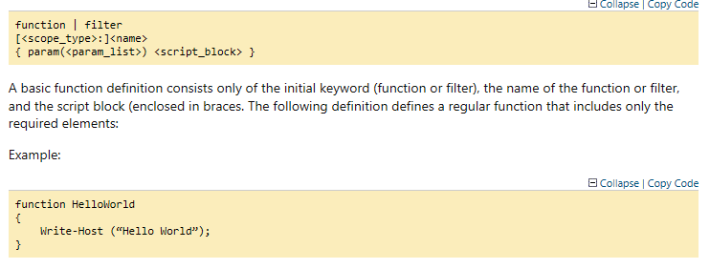
Functions…
As in other programming languages, you can define callable functions…

Slide 73
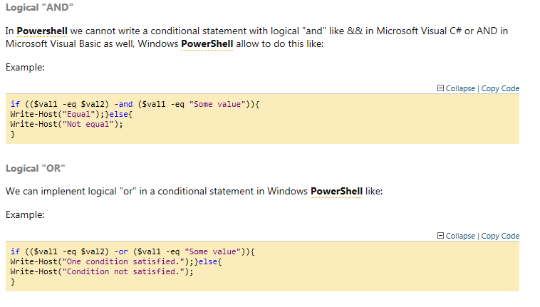
IF Examples (Logical AND/OR)…

Slide 74
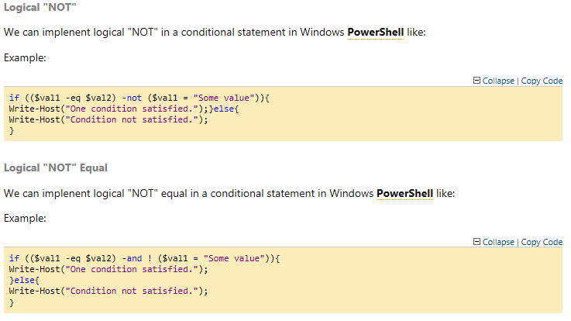
IF Examples (Logical Not/Not Equal)…

Slide 75
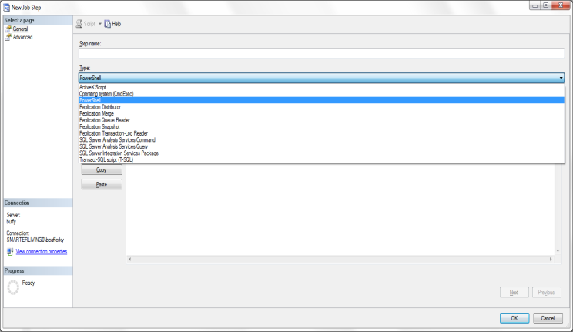
SQL Agent: Built In Support for PowerShell
Notes:
Give a brief overview of the presentation. Describe the major focus of the presentation and why it is important.
Introduce each of the major topics.
To provide a road map for the audience, you can repeat this Overview slide throughout the presentation, highlighting the particular topic you will discuss next.

Slide 76
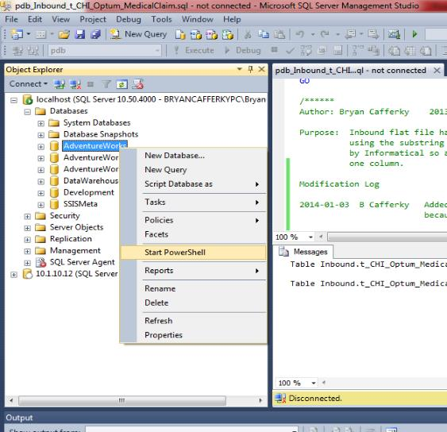
SSMS: Built In Support for PowerShell
Notes:
Give a brief overview of the presentation. Describe the major focus of the presentation and why it is important.
Introduce each of the major topics.
To provide a road map for the audience, you can repeat this Overview slide throughout the presentation, highlighting the particular topic you will discuss next.

